Slide 1

AAE 875 – Fundamentals of Object Oriented Programming and Data Analytics
Cornelia Ilin, PhD
Department of Ag & Applied Economics
UW-Madison
Week 3 - Summer 2019

Slide 2

OOP in Python
OOP is a very well known concept used to write powerful applications
As a data analyst you will be required to write code to process the data
Development in OOP is faster and cheaper; leads to high quality code
With OOP you describe how a program should operate
With declarative programming languages you describe what you want to accomplish without specifying how

Slide 3
OOP in Python
OOP uses the concept of objects and classes
A class can be thought as a blueprint for objects that have their own attributes (characteristics they possess), and methods (actions they perform)

Slide 4
OOP in Python
An example of a class is the class Dog (don’t think of a particular dog)
With a class we are trying to explain what a dog is and can do, in general
Dogs usually have a name and age. There are called instance attributes
Dogs can also bark. This is a method

Slide 5


OOP in Python
Let’s talk about two dogs: Maika and Bonnie
A specific dog is considered an object in OOP
An object is an instance of the class Dog
This is the basic principle of OOP
Remember Exam 1 is on Friday between 10-12 pm. Don’t relax!

Slide 6
OOP in Python
So Maika and Bonnie belong to the class Dog
Their attributes are:
name: [“Maika”, “Bonnie”]
age: [2, 1]

Slide 7
OOP in Python
Python is a great programming language that supports OOP
You can use it to define attributes and methods, which you can later call
Unlike other OOP languages (e.g. Java), it is based on dynamic typing
So you don’t need to declare the type of variables and arguments
Python code is easier to read and intuitive

Slide 8
Chapter 8: Classes
Definition
Constructor
Instantiation
Class, instance, method object
User-defined methods
Class vs. instance attributes

Slide 9
Class definition
Classes provide a high-level approach to organize a program
Classes are objects containing groups of related variables and functions
Let's learn from an example:
Assume we have a database with patient info, such as: age, weight, asthma
We can create a class (object) Patients with attributes age, weight, asthma
This can be done using the class keyword and the __init__(self) constructor

Slide 10
Class definition
Classes provide a high-level approach to organize a program
Classes are objects containing groups of related variables and functions
Let's learn from an example:
Assume we have a database with patient info, such as: age, weight, asthma
We can create a class (object) Patients with attributes age, weight, asthma
This can be done using the class keyword and the __init__(self) constructor
class Patients:
def __init__(self):
self.age = 0
self.weight = 0 #in Kg
self.asthma = 0 #1 if yes
Note: use initial capitalization for class names (e.g. Patients, PatientInfo etc)
In this example attributes are set to 0

Slide 11
Class constructor
Functions defined within a class are called methods
The __init__() method is a constructor
The constructor is a special method with no return type and one required parameter (self)
It's called when creating an instance of the class (instance = add new entry, e.g. new patient information)

Slide 12
Class constructor
One can add additional parameters to the __init__ method (the constructor)
class Patients:
def __init__(self, year, month):
self.age = 0
self.weight = 0 #in Kg
self.asthma = 0 #1 if yes

Slide 13
Class constructor
One can add additional parameters to the __init__ method (the constructor)
These additional parameters can be added as instance attributes (can be accessed later)
class Patients:
def __init__(self, year, month):
self.age = 0
self.weight = 0 #in Kg
self.asthma = 0 #1 if yes
self.year = year
self.month = month

Slide 14
Class constructor
One can add additional parameters to the __init__ method (the constructor)
These additional parameters can be added as instance attributes (can be accessed later)
Additional parameters can be set to default values
class Patients:
def __init__(self, year = 2019, month = 'January'):
self.age = 0
self.weight = 0 #in Kg
self.asthma = 0 #1 if yes
self.year = year
self.month = month

Slide 15
Class instantiation
To define a new Patients class variable (i.e. add patient with corresponding health information, aka instance) use instantiation
Instantiation is performed by calling the class name, similar to calling a function
When only the required self parameter is present, then the class call doesn't include any arguments
class Patients:
def __init__(self):
self.age = 0
self.weight = 0 #in Kg
self.asthma = 0 #1 if yes
patient1 = Patients()
class instantiation

Slide 16
Class instantiation
To define a new Patients class variable (i.e. add patient with corresponding health information, aka instance) use instantiation
Instantiation is performed by calling the class name, similar to calling a function
When additional parameters are present (with no default values), then the class call includes arguments for the additional parameters
class Patients:
def __init__(self, year, month):
self.age = 0
self.weight = 0 #in Kg
self.asthma = 0 #1 if yes
self.year = year
self.month = month
patient1 = Patients(2017, 'January')
class instantiation when additional parameters with no default values are present

Slide 17
Class instantiation
To define a new Patients class variable (i.e. add patient with corresponding health information, aka instance) use instantiation
Instantiation is performed by calling the class name, similar to calling a function
When additional parameters are present (with default values), then the class call doesn't include arguments for the additional parameters
class Patients:
def __init__(self, year = 2019, month = 'January'):
self.age = 0
self.weight = 0 #in Kg
self.asthma = 0 #1 if yes
self.year = year
self.month = month
patient1 = Patients()
class instantiation when additional parameters with default values are present

Slide 18
Class instantiation
To define a new Patients class variable (i.e. add patient with corresponding health information, aka instance) use instantiation
Instantiation is performed by calling the class name, similar to calling a function
One can add a mix of additional parameters w/ and w/o default values. Arguments w/o default values must come first, and must be in order!
class Patients:
def __init__(self, month, year = 2019):
self.age = 0
self.weight = 0 #in Kg
self.asthma = 0 #1 if yes
self.year = year
self.month = month
patient1 = Patients('January')

Slide 19
Class instantiation
To define a new Patients class variable (i.e. add patient with corresponding health information, aka instance) use instantiation
Instantiation is performed by calling the class name, similar to calling a function
The instantiation operation automatically calls the constructor (__init__ method)
class Patients:
def __init__(self):
self.age = 0
self.weight = 0 #in Kg
self.asthma = 0 #1 if yes
patient1 = Patients()
instantiation calls the constructor to create a new instance (self) of the class

Slide 20
Class instantiation
To define a new Patients class variable (i.e. add patient with corresponding health information, aka instance) use instantiation
Instantiation is performed by calling the class name, similar to calling a function
The instantiation operation automatically calls the constructor (__init__ method)
The required parameter of the __init__ method (self) references each new instance created
class Patients:
def __init__(self):
self.age = 0
self.weight = 0 #in Kg
self.asthma = 0 #1 if yes
patient1 = Patients()
default parameter is 'self'

Slide 21
Class instantiation
To define a new Patients class variable (i.e. add patient with corresponding health information, aka instance) use instantiation
Instantiation is performed by calling the class name, similar to calling a function
The instantiation operation automatically calls the constructor (__init__ method)
The required parameter of the __init__ method (self) references each new instance created
class Patients:
def __init__(self):
self.age = 0
self.weight = 0 #in Kg
self.asthma = 0 #1 if yes
patient1 = Patients()
# set attribute values for the instance created above
patient1.age, patient1.weight, patient1.asthma = 30, 60, 0
attributes are accessed using the dot notation

Slide 22
Top Hat Question # 1
What is a class?
Answer:

Slide 23
Top Hat Question # 2
What is __init__?
Answer:

Slide 24
Top Hat Question # 3
What is an instance of a class?
Answer:

Slide 25
Top Hat Question # 4
What is the output?
class Patients:
def __init__(self, year = 2020, month):
self.age = 0
self.weight = 0 #in Kg
self.asthma = 0 #1 if yes
self.year = year
self.month = month
patient1 = Patients('January')
print(patient1.month)

Slide 26
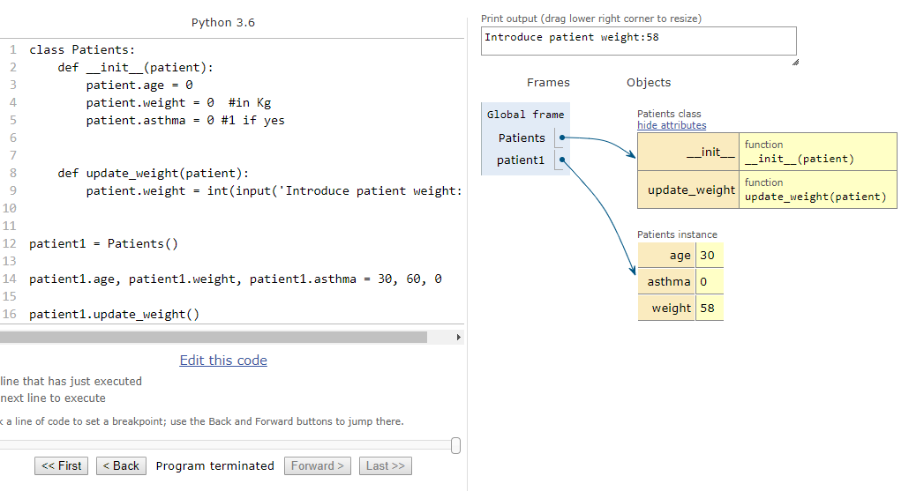
Class vs. instance object
A class object creates new class instances
An instance object represent a single instance of a class
Class object
Instance object

Slide 27
User-defined methods
A class definition may include user-defined methods
Example: update patient weight after each visit
class Patients:
def __init__(self):
self.age = 0
self.weight = 0 #in Kg
self.asthma = 0 #1 if yes
def update_health(self):
self.weight = int(input('Introduce patient weight: '))

Slide 28
User-defined methods
A class definition may include user-defined methods
Example: update patient weight after each visit
The parameter of the user-defined method has to match the required parameter of the constructor method!
class Patients:
def __init__(self):
self.age = 0
self.weight = 0 #in Kg
self.asthma = 0 #1 if yes
def update_health(self):
self.weight = int(input('Introduce patient weight: '))

Slide 29
User-defined methods
How do we call a user-defined method? (E.g. how do we update the weight of a patient?)
class List:
def __init__(self):
self.age = 0
self.weight = 0 #in Kg
self.asthma = 0 #1 if yes
def update_health(self):
self.weight = int(input('Introduce patient weight: '))
patient1 = Patients()
patient1.age = 30
patient1.weight = 60
patient1.asthma = 0
patient1.update_health()
No argument was provided!

Slide 30
Top Hat Question # 5
What is patient1's asthma status if user input is 1?
class Patients:
def __init__(self):
self.age = 0
self.weight = 0 #in Kg
self.asthma = 0 #1 if yes
def update_health():
self.asthma = int(input('Introduce patient asthma status (1 = yes): ')
patient1 = Patients()
patient1.age = 30
patient1.weight = 60
patient1.asthma = 0
patient1.update_health()

Slide 31
Top Hat Question # 6
Is the method update_health() correctly defined?
class Patients:
def __init__(self, year):
self.age = 0
self.weight = 0 #in Kg
self.asthma = 0 #1 if yes
self.year = year
def update_health(self):
self.asthma = int(input('Introduce patient asthma status (1 = yes): ')
patient1 = Patients()
patient1.age = 30
patient1.weight = 60
patient1.asthma = 0
patient1.update_health()

Slide 32
Class vs. Instance attributes
A class attribute is shared among all instances of that class
Defined within the scope of the class
An instance attribute can be unique to each instance
Defined using dot notation from within a method or from outside of the class scope
When using dot notation the instance namespace is searched first followed by the class namespace
class Patients:
year = 2018
def __init__(self):
self.age = 0
self.weight = 0 #in Kg
self.asthma = 0 #1 if yes
patient1 = Patients()
patient2 = Patients()
patient1.age, patient1.weight, patient1.asthma = 30, 60, 0
patient2.age, patient2.weight, patient2.asthma = 28, 55, 1
Class attribute
Instance attributes

Slide 33
Class vs. Instance attributes
A class attribute is shared among all instances of that class
Defined within the scope of the class
An instance attribute can be unique to each instance
Defined using dot notation from within a method or from outside of the class scope
When using dot notation the instance namespace is searched first followed by the class namespace
Good practice: avoid using same names for class and instance attributes!!

Slide 34
Class vs. Instance attributes
How we can use class attributes?
class Patients:
year = 2018
def __init__(self):
self.age = 0
self.weight = 0 #in Kg
self.asthma = 0 #1 if yes
patient1 = Patients()
patient2 = Patients()
patient1.age, patient1.weight, patient1.asthma = 30, 60, 0
patient2.age, patient2.weight, patient2.asthma = 28, 55, 1
print(patient1.year)
patient1.year = 2019
print(patient1.year)

Slide 35
Top Hat Question # 7
How many attributes does patient1 has? How many patient2?
class Patients:
year = 2018
def __init__(self):
self.age = 0
self.weight = 0 #in Kg
self.asthma = 0 #1 if yes
patient1 = Patients()
patient2 = Patients()
patient1.age, patient1.weight, patient1.asthma = 30, 60, 0
patient2.age, patient2.weight, patient2.asthma = 28, 55, 1
print(patient1.year)
patient1.year = 2019
print(patient1.year)

Slide 36
An example w/ classes
class Student(object):
def __init__(self, name, age, gender, level, grades=None):
self.name = name
self.age = age
self.gender = gender
self.level = level
self.grades = grades or {}
def setGrade(self, course, grade):
self.grades[course] = grade
def getGrade(self, course):
return self.grades[course]
def getGPA(self):
return sum(self.grades.values())/len(self.grades)
# Define some students
john = Student("John", 12, "male", 6, {"math":3.3})
jane = Student("Jane", 12, "female", 6, {"math":3.5})
# Now we can get to the grades easily
print(john.getGPA())
print(jane.getGPA())

Slide 37
Same example w/ dictionaries
def calculateGPA(gradeDict):
return sum(gradeDict.values())/len(gradeDict)
students = {}
# We can set the keys to variables so we might minimize typos
name, age, gender, level, grades = "name", "age", "gender", "level", "grades"
john, jane = "john", "jane"
math = "math"
students[john] = {}
students[john][age] = 12
students[john][gender] = "male"
students[john][level] = 6
students[john][grades] = {math:3.3}
students[jane] = {}
students[jane][age] = 12
students[jane][gender] = "female"
students[jane][level] = 6
students[jane][grades] = {math:3.5}
# At this point, we need to remember who the students are and where the grades are stored. Not a huge deal, but avoided by OOP.
print(calculateGPA(students[john][grades]))
print(calculateGPA(students[jane][grades]))

Slide 38
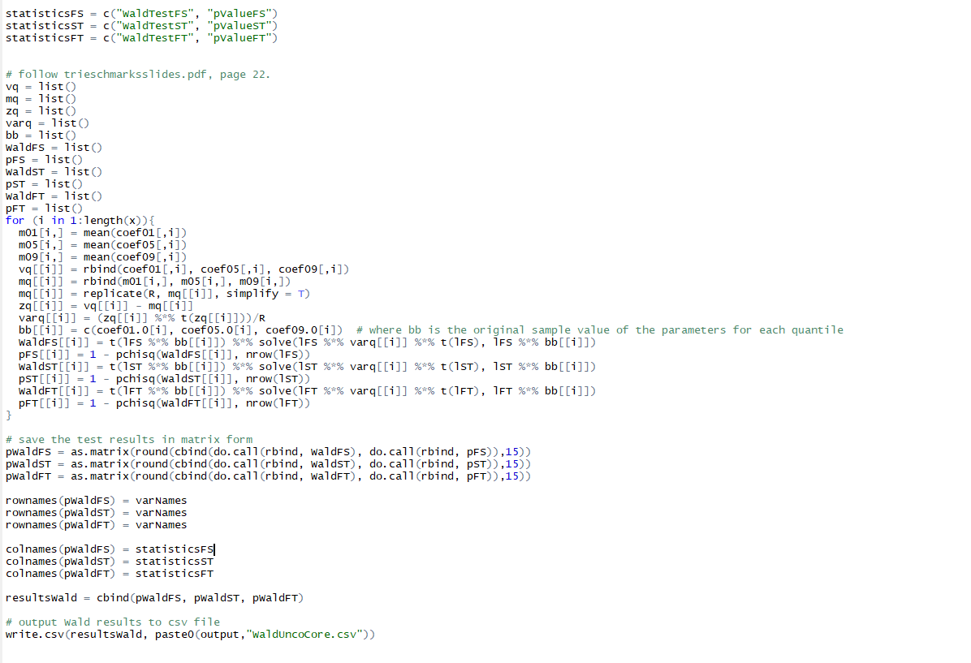
Hard to read code (in R), poorly commented

Slide 39
Chapter 9: Exceptions
Handling exceptions
Multiple exceptions
Raising exceptions
Using finally to cleanup
Custom exception types

Slide 40
Chapter 10: Modules
Modules
Packages
Library

Slide 41
Modules - definitions
What is the difference between a module and a script?
The main script calls modules
Modules can also call other modules

Slide 42
Module - definitions
Good programming practice is to have a:
Main script (calls modules)
Modules (can also call other modules)
A module is called by the main script (or other modules) using the import command
main.py
products.py
quantities.py
modules
(imported by the main script or other modules)
main script
(passed as input to the interpreter)
prices.py

Slide 43
Module - definitions
Good programming practice is to have a:
Main script (calls modules)
Modules (can also call other modules)
A module is called by the main script (or other modules) using the import command
main.py
products.py
# list product categories
import products
print('Store A product is:', products.store_A)
print('Store B product is:', products.store_B)
store_A = 'Organges'
store_B = 'Apples'

Slide 44
Module - definitions
Good programming practice is to have a:
Main script (calls modules)
Modules (can also call other modules)
A module is called by the main script (or other modules) using the import command
main.py
products.py
# list product categories
import products
print('Store A product is:', products.store_A)
print('Store B product is:', products.store_B)
store_A = 'Organges'
store_B = 'Apples'
# Executes only if run as a main script
if __name__ == '__main__'
print(' Store A product is', store_A)

Slide 45
Modules - definitions
How do you deal with long and difficult scripts?
Split code into main script and modules
Code written in a single file is hard to read

Slide 46
Modules - definitions
You want to create new instances of the Dog class. Multiple modules require the use of the Dog class.
What is the most efficient way to write code to define this class?
Create a module that contains this class only; or a module that contains a collection of classes. The main idea is to create the class only once (avoid repetitions of the same code)

Slide 47
Modules - definitions
What happens when you import a module? i.e. what is printed out in the Console?
The Python interpreter automatically runs the module imported. For example, if the imported module contains any print statements you will see the output in the Console.

Slide 48
Modules - definitions
Assume you have created a module named my_world
Are modules case sensitive? What happens if you type import my_World
Python is a case-sensitive programming language. A Syntax Error will stop the execution of your code.

Slide 49
Modules - definitions
Where do you usually write import statements?
Good practice is to add them at the top of the file

Slide 50
Modules - definitions
What is a built-in module
Exists in the Python library

Slide 51
Modules - definitions
How can you import specific names from a module?
Using dot (.) notation

Slide 52
Modules - definitions
How can you execute a module as a script?
Add command if __name__ == “__main__”

Slide 53
Packages - definitions
What is a package in Python?
A collection of modules

Slide 54
Library - definitions
What is Python’s standard library
Built-in packages (that come pre-installed with Python)

Slide 55
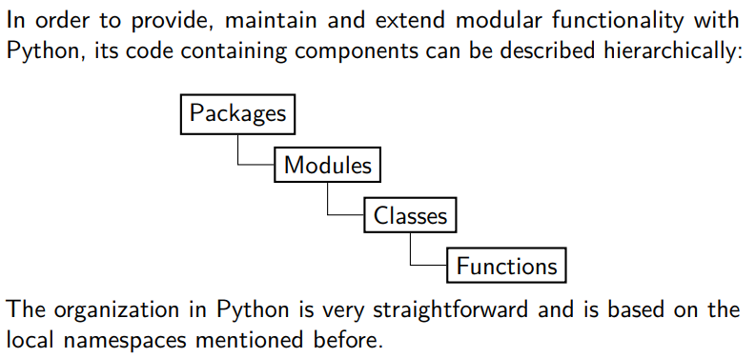
Managing code in Python

Slide 56
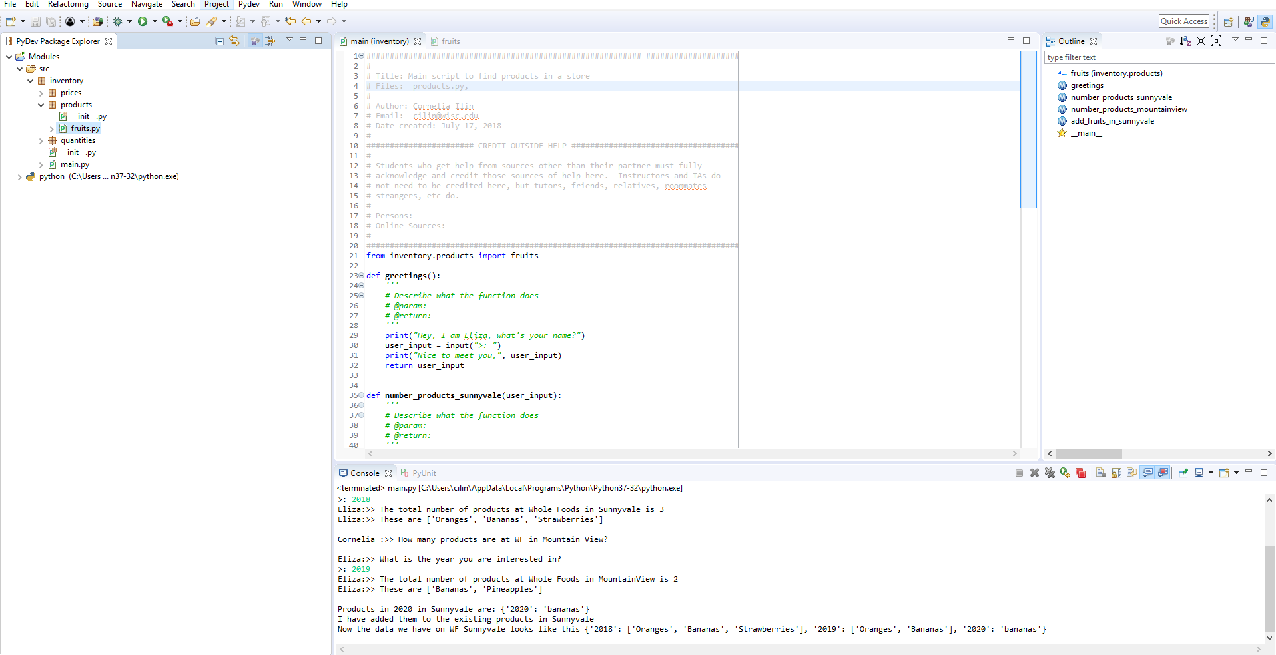
Creating a package called “inventory”

Slide 57
References
OOP in Python:
https://www.datacamp.com/community/tutorials/python-oop-tutorial
An example w/ and w/o classes:
https://stackoverflow.com/questions/33072570/when-should-i-be-using-classes-in-python
Managing code:
https://pyecon.org/down/pyecon.pdf

